Slide 1
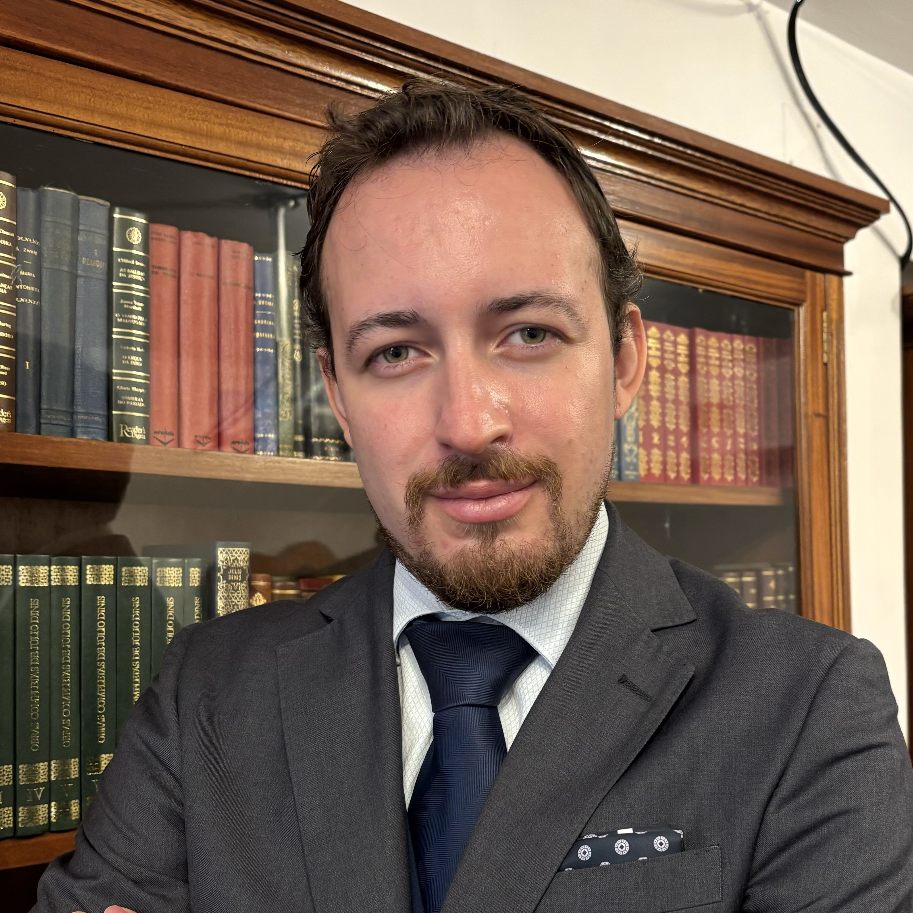
Daniel Vital de Alcântara
Consultant, True North Partners
Daniel has over 5 years of experience in risk management consulting to the financial services industry
Prior to joining True North Partners, Daniel worked for Deloitte Risk Advisory and Strategy Risk & Transactions for Financial Services
He has worked with senior management of leading financial institutions and regulators in the banking and insurance industry, including in Portugal and Angola.
His project experience focuses on themes in finance and risk:
Implementation of methodologies for Collective Impairment calculation, to Risk Factors, required for the definition and implementation of Impairment Losses Models for the Credit and Securities Portfolios;
Development of Risk Management Processes, including the implementation of the corresponding tools/engines to support the Impairment Models of Collective and Individual Credit Portfolio Analysis;
Support in the definition and validation of all models including loss reserving necessary to support the requirements of the IFRS 17 norm.
He holds a B.Sc. in Mathematics from Universidade Nova de Lisboa and a M.Sc. in Mathematical Finance from Lisbon School of Economics & Management (ISEG).
Notes:
Clients
Insurance
Lusitania (Portugal)
Daniel worked on the implementation of the IFRS 17 norm, and all the requirements necessary to achieve compliance, including the definition of methodologies and validation of the loss reserving models.
Banks
Banco Santander (Portugal)
Daniel worked on the extraction and validation of the data required for the on-site inspection of the IFRS9 models.
BPI (Portugal)
Daniel worked on the implementation of the IRB (Internal Ratings-based) approach to capital requirements for credit risk. In specific he was involved in the devolvement of the models for LGD (Loss given default).
BFA (Angola)
Daniel worked on the recalibration of the credit risk models, in particular he worked on the PD (probability of default) model, the LGD model, the CCF (Credit Conversion factor) model, the total pre payment model and the BM (Behavioural Maturity) model.
BPF (Portugal) CGD (Portugal), BST (Portugal)

Slide 2
Our Team
Daniel V.
de Alcântara
Daniel Vital
de Alcântara
5+ years - Deloitte in Financial Services Risk Advisory and Strategy Risk & Transactions (Senior Consultant)
Bachelors in Mathematics from Universidade Nova de Lisboa and a Masters in Mathematical Finance from Lisbon School of Economics & Management (ISEG)
Project experience in IFRS 9, IRB and IFRS 17 norms.
Experience in the Banking and Insurance Industries in Portugal and Angola
5+ years - Bachelors in Mathematics from Universidade Nova de Lisboa and a Masters in Mathematical Finance from Lisbon School of Economics & Management (ISEG)

